Slide 1

Python for Data Science
Week 1
Mentor Learning Session

Slide 2
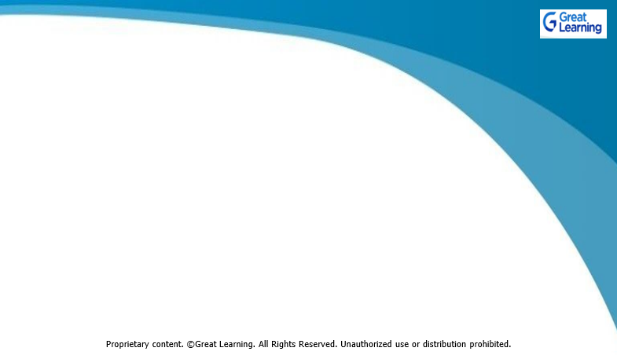

Expectation Setting
Make sure you watch all the videos and understand the concept thoroughly before joining the Mentor Learning Session.
Mentor Learning Sessions are not walkthrough of what is already covered in the videos. It will focus more on application. Case Study will be discussed to indicate how best knowledge can be applied in various real situations.
Be Punctual and try to login on time to get the best learning experience.

Slide 3
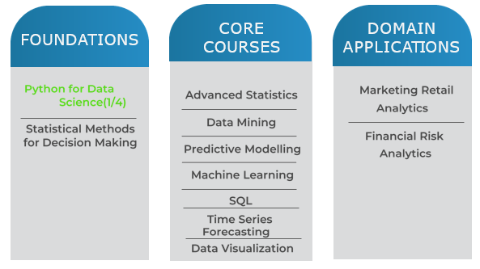
DSBA Curriculum Design
Current status:

Slide 4
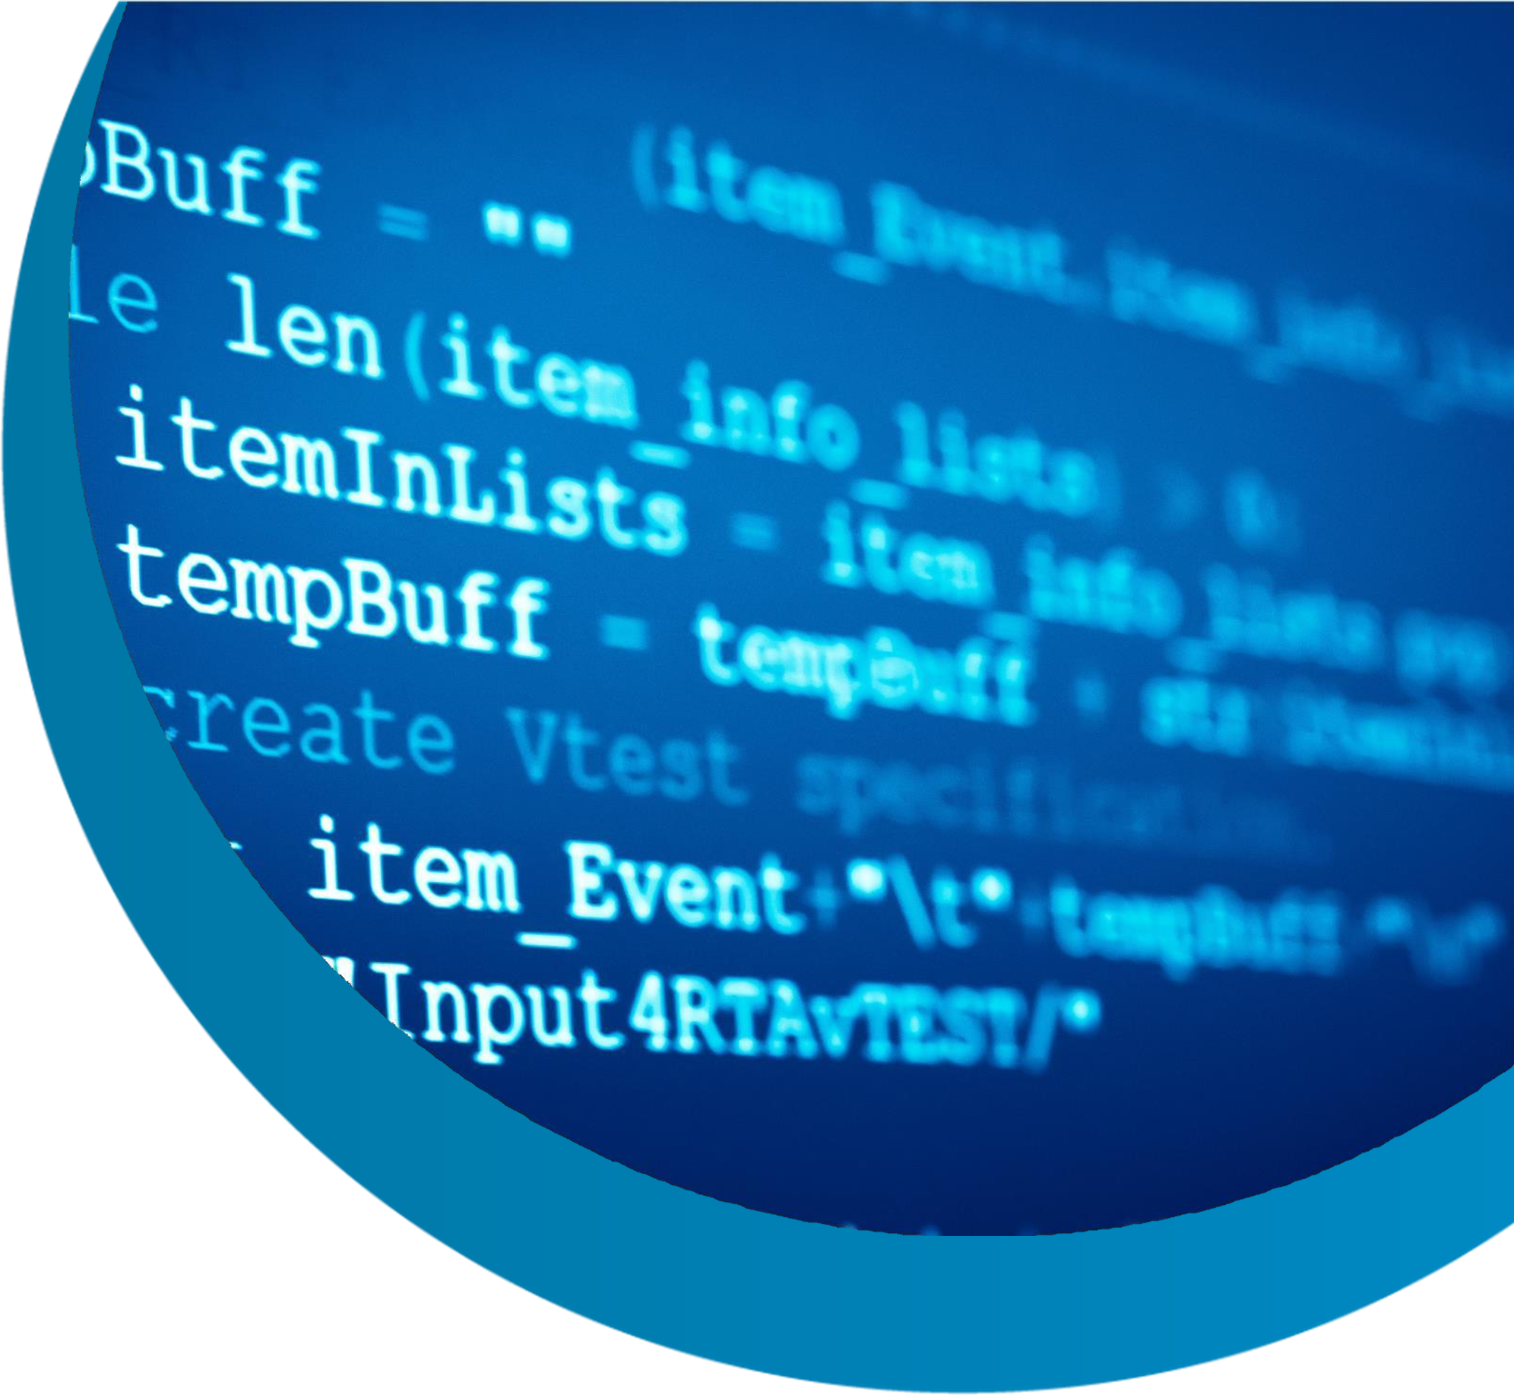
Learning objective of PDS :
Basics of Python (Week 1)
Numpy and Pandas -
Data Manipulation using Python
(Week 2)
Data Visualization using Python (Week 3)

Slide 5
Learning objective of current Mentor Learning Session
Basics of Python (Week 1)
What is Data Science?
A few read world examples where Data Science is applied
What is Python?
Interesting Hands-on exercise :
User defined functions
Conditional statements to build your own game.

Slide 6
































































































Slide 7



















































Slide 8
What is Data Science?
Data Science is a combination of mathematics, statistics and
programming skills along with subject expertise which helps to analyze data and extract meaningful insights from it that can help decision makers make informed decisions.
Data Science is applied in almost every field today including
e-commerce, medical sciences, finance, manufacturing,
human resources etc.
To know more:
https://www.mygreatlearning.com/blog/what-is-data-science/

Slide 9
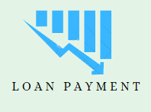
A few read world examples where Data Science is applied
predict and understand the applicant's profile to minimize the risk of future loan defaults.
Some basic questions that should be answered:
The bank want to know the clients who have high probability to default.
What type of information I would need about the client to know the risk?

Slide 10
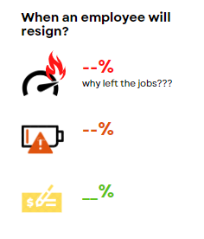
To predict when can an employee resign
What type of information do we need to make an informed decision ?
If my company is a 40-50 years old company, should one use all the available data to proceed with this analysis?

Slide 11

Who will win next Cricket World Cup?
Can you guess?
Your guess is based on?
Do you think any past information will help better in getting results?

Slide 12
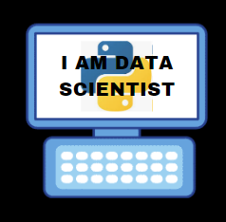
What is python?
Python is considered a popular programming language for beginners.
As a powerful and extremely versatile programming language, it is used almost in every industry now and for many different types of coding projects as it is rich in libraries.
In this course we will only focus on Numpy, Pandas along with seaborn, matplotlib which are the most important libraries from Data Science point of you.

Slide 13
Use Google colab or Jupyter notebook
For writing python codes, there are 2 platforms in this program:
Either Download install Anaconda and then launch Jupyter notebook
Or
Just visit google colab : https://colab.research.google.com/ and start writing your python codes without any hassle. (no downloading required)

Slide 14

Installation guidelines
Have you installed jupyter notebook or working on google colab?
Install Python 3.6 or higher version
1) Anaconda 5.2 For Linux Installer
https://www.anaconda.com/download/#linux
2) Anaconda 5.2 For macOS Installer
https://www.anaconda.com/download/#macos
3) Anaconda 5.2 For Windows Installer
https://www.anaconda.com/download/#windows
Launch Jupyter
download the version compatible with your OS

Slide 15
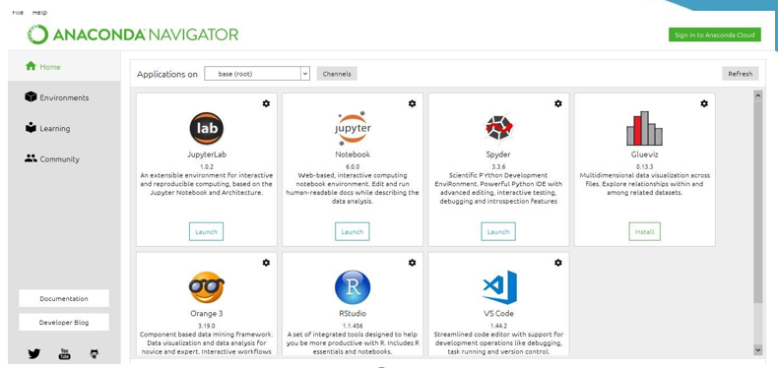
ANACONDA NAVIGATOR

Slide 16
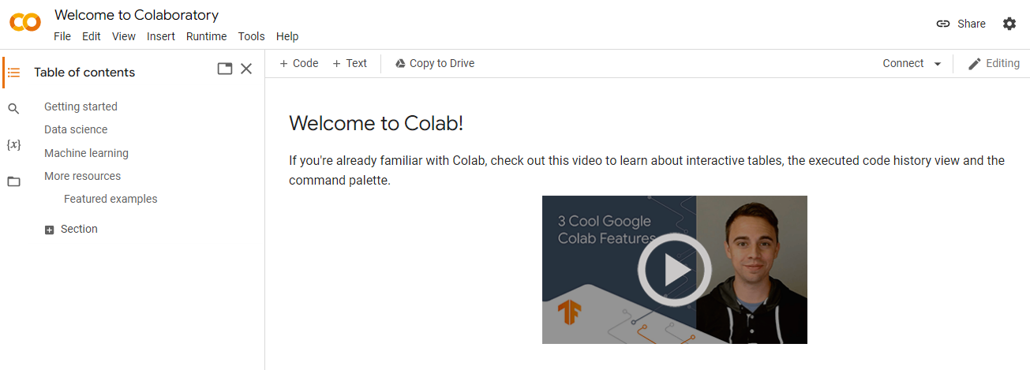
Google colab
https://colab.research.google.com/

Slide 17
Hands-on Exercise
User defined function:
Check if the number is prime or not;
Count all the prime numbers in a list;
Reversing a list ;
return unique elements from a list.
Conditional statement:
Have you played Paper, Stone, Scissor game?
Let’s try these games on python now.
While and for loop
Get the square of even numbers.
Calculate gst amount & net price for a local shopkeepers.

Slide 18
How to debug your code?
Try to debug on your own by reading & understanding the error
message- This is an essential step in the learning process.
Refer to Python Codebooks shared in the Program Overview course.
Discuss it with the Peers over WhatsApp groups. It will help others in the group to understand various nuances of coding.
Search your problem on GL Community. It takes time to build competency in Python. Even the experts regularly search for help on platforms like StackOverflow.
Get your query resolved in the Mentor Sessions or via Program Support feature available in Olympus.

Slide 19
Any Doubts?

Slide 20

Thank You !!
Happy Learning

